Slide 1

Laptop Price Analysis
Presented by: Ujwala Tejaswani Dhanenkula
CONTENTS
INTRODUCTION
PROBLEM STATEMENT
DATASET
UNDERSTANDING OF DATA
EXPLORATORY DATA ANALYSIS
MODEL SELECTION
CONCLUSION

Slide 2

INTRODUCTION
Laptops are essential in today's digital era, with prices varying based on brand, specifications, and market trends.
Understanding the factors that influence laptop pricing can help consumers make informed purchasing decisions and assist businesses in optimizing pricing strategies.
By identifying the most influential features affecting laptop prices, this analysis provides valuable insights into pricing trends, budget-friendly options, and premium laptop categories, helping both buyers and sellers in the market

Slide 3

PROBLEM STATEMENT
The laptop market offers a wide range of options with varying specifications and prices, making it challenging for consumers to make informed purchasing decisions.
This project aims to analyze laptop prices based on key factors such as Company, processor, RAM, storage, and other features.
By leveraging data analysis techniques, the goal is to identify price trends, correlations, and insights to help buyers and sellers understand pricing dynamics in the market.

Slide 4
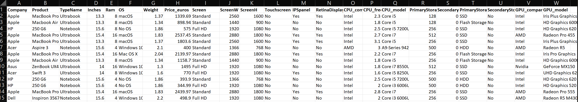
DATASET
This analysis utilized a well-structured dataset that enhances our project's accuracy and insights by providing clean, relevant, and comprehensive data for analysis.
It helps analyze pricing trends, brand comparisons, and feature impact on cost. This dataset is ideal for data visualization, statistical analysis, and predictive modeling.

Slide 5
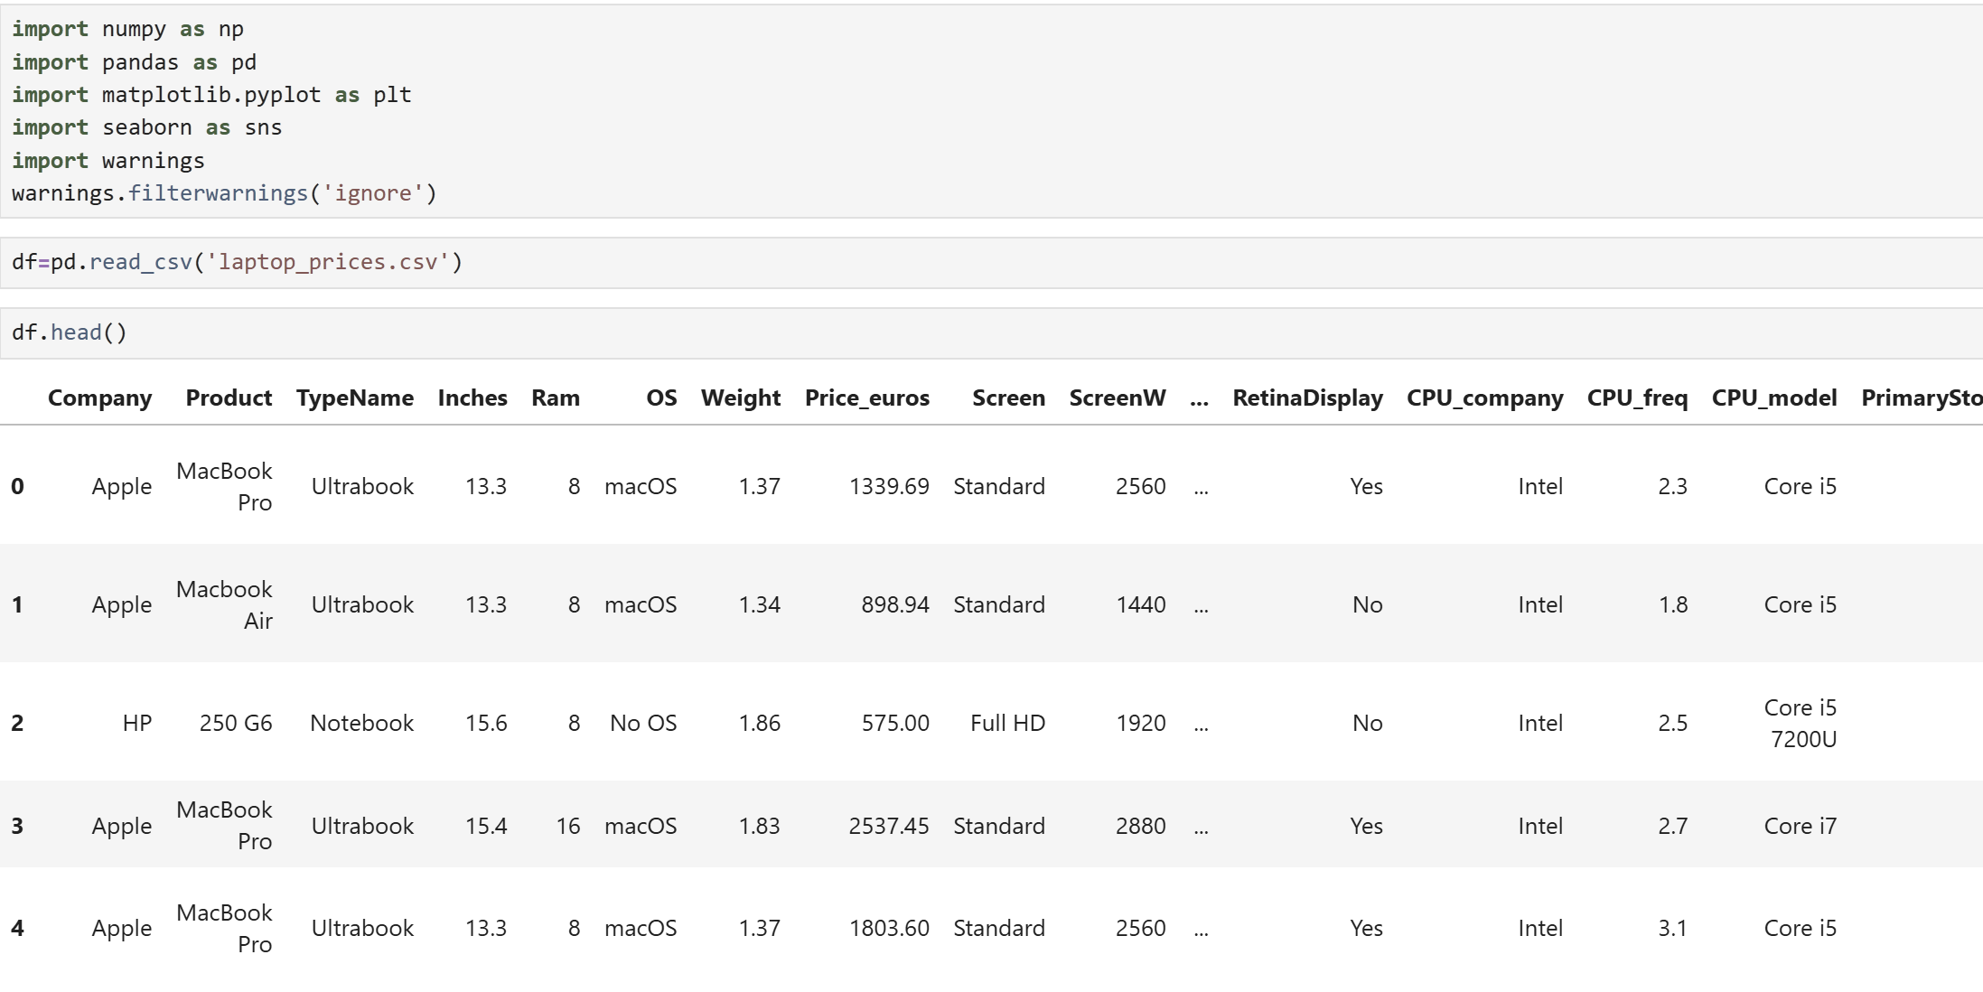
UNDERSTANDING OF DATA
Let’s start working on our dataset by
Importing the required libraries for data manipulation.
Loading the dataset using Pandas.

Slide 6
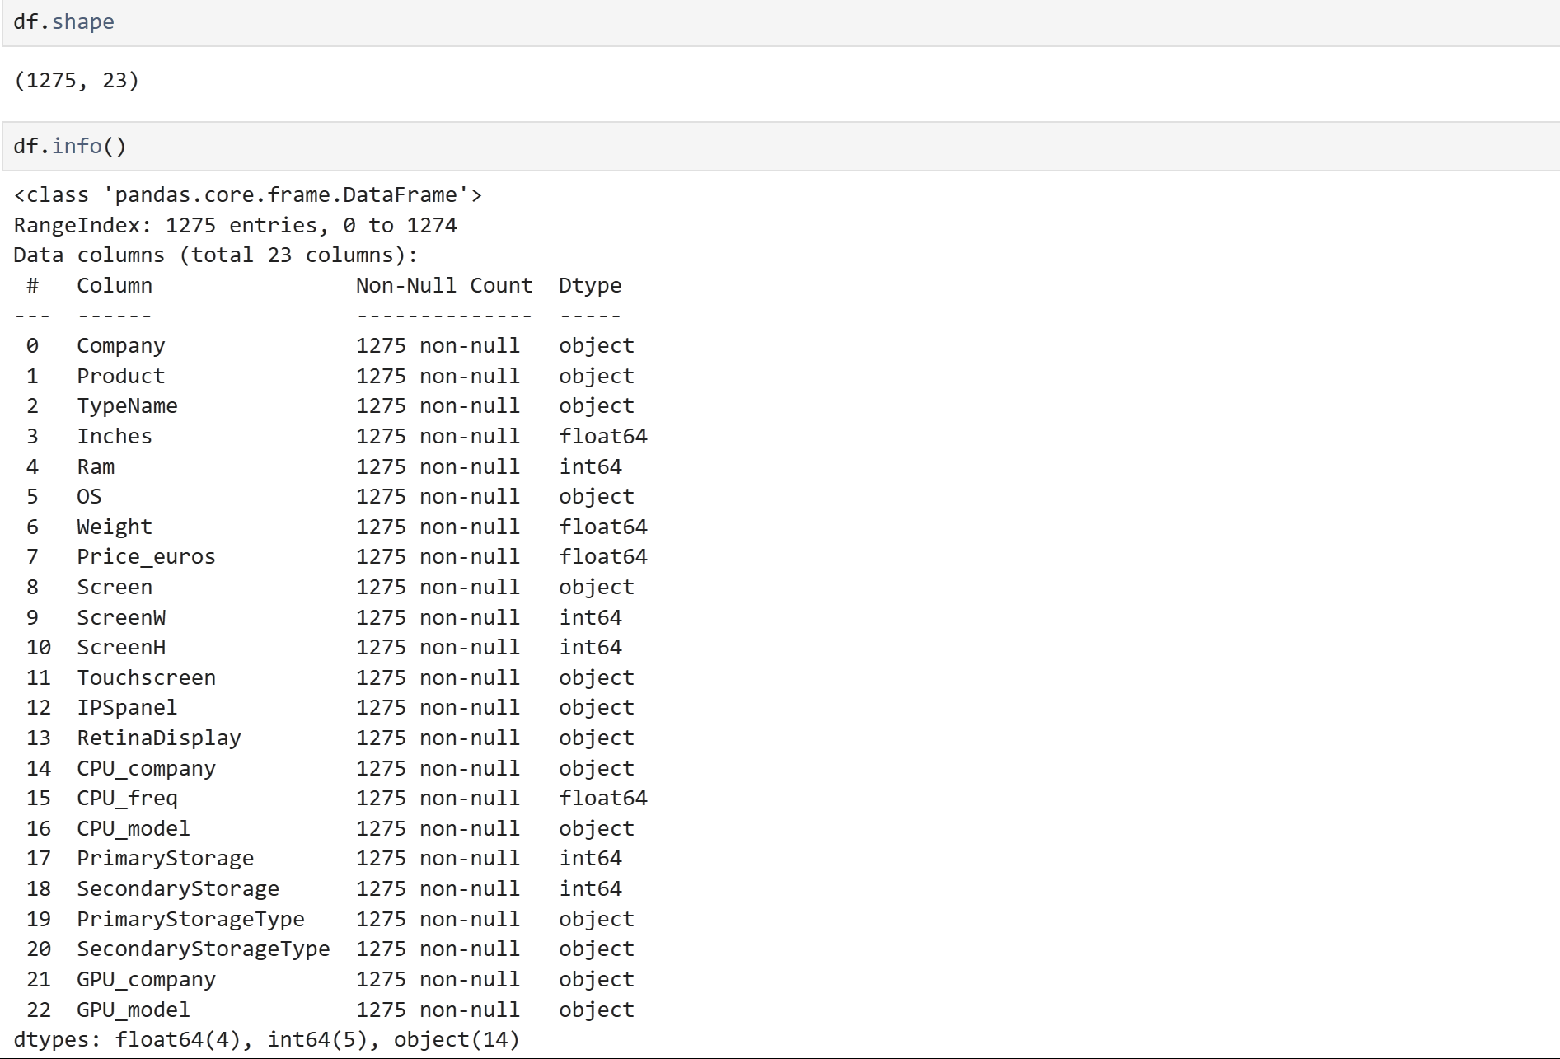
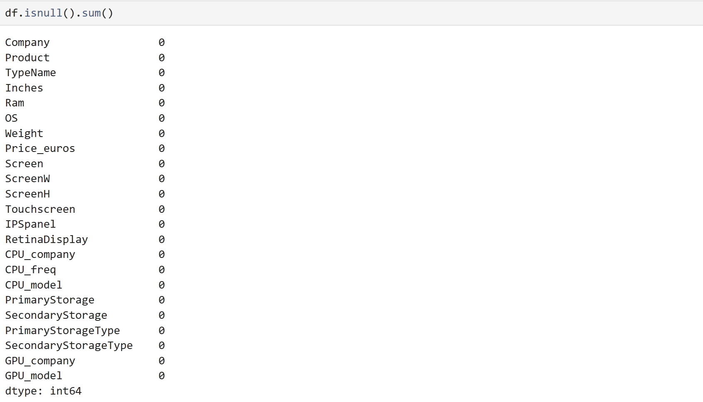

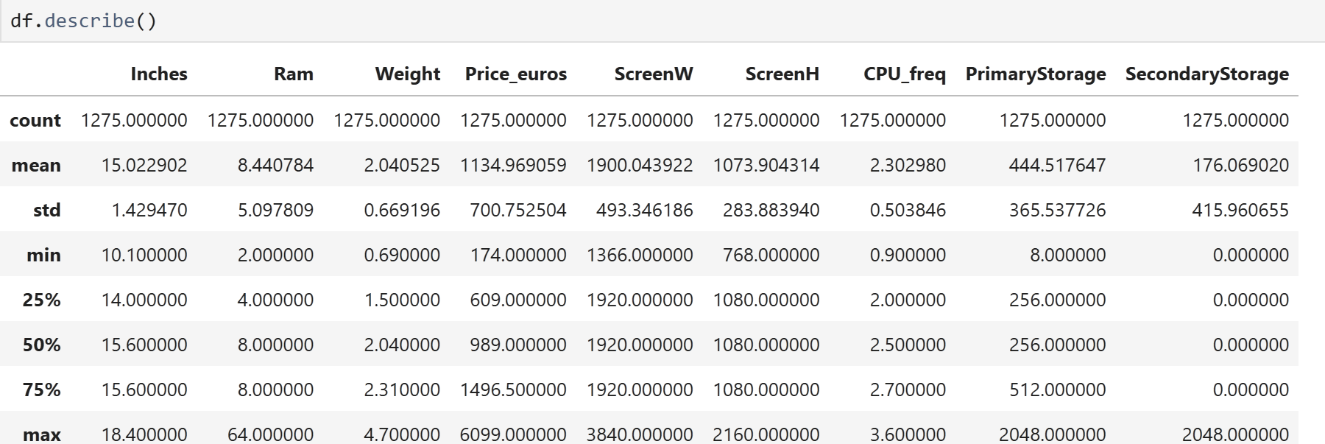
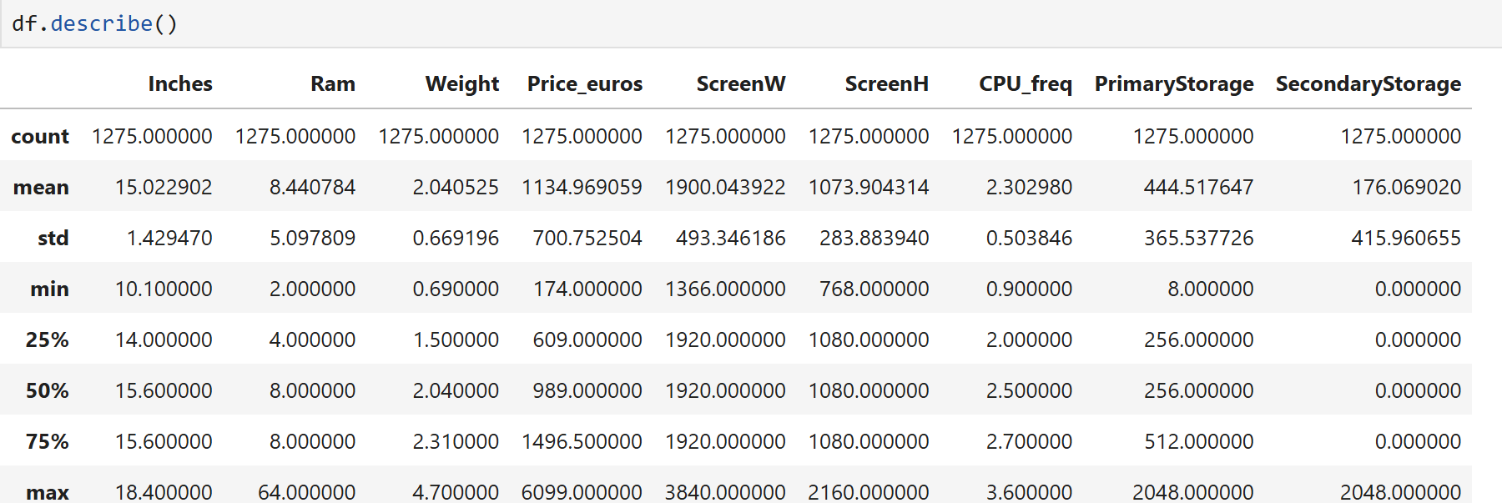
Data Preprocessing
Let’s take a quick basic understanding of data like shape, info and check if we have any null values.
we can see that there are 1275 rows and 23 columns
It is good that there are no null values in our dataset.

Slide 7

EXPLORATORY DATA ANALYSIS
Exploratory Data Analysis (EDA) involves understanding the dataset through statistical summaries, visualizations, and pattern detection.
It includes checking for missing values, analyzing distributions of price and specifications, identifying correlations between features, and detecting outliers.
EDA helps uncover insights like how different specifications impact laptop prices and guides further analysis or predictive modeling.
Let’s get started with analysing the data and then Visualization for better understanding.

Slide 8
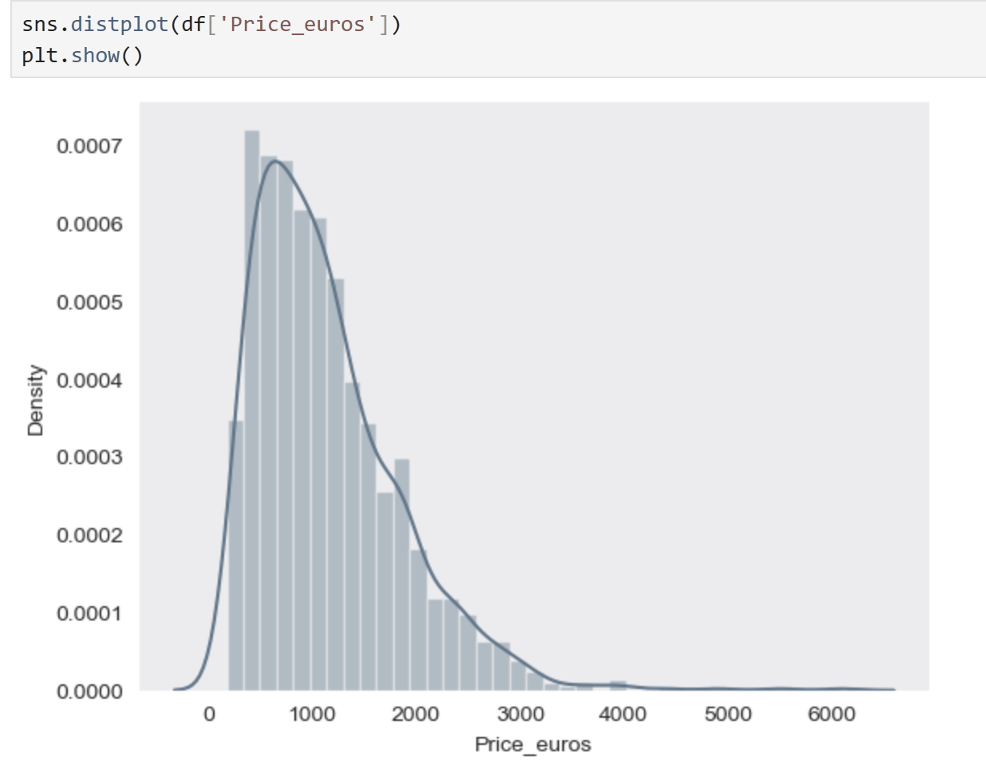
1. Distribution of Price
For this dataset, we are taking price as our target column and we are going to compare remaining attributes with price. So, It’s very important to understand the ‘Price’ distribution.
We can see that
Our target column right skewed.
Low priced laptops are sold more than the branded ones.
It is not normally distributed.

Slide 9
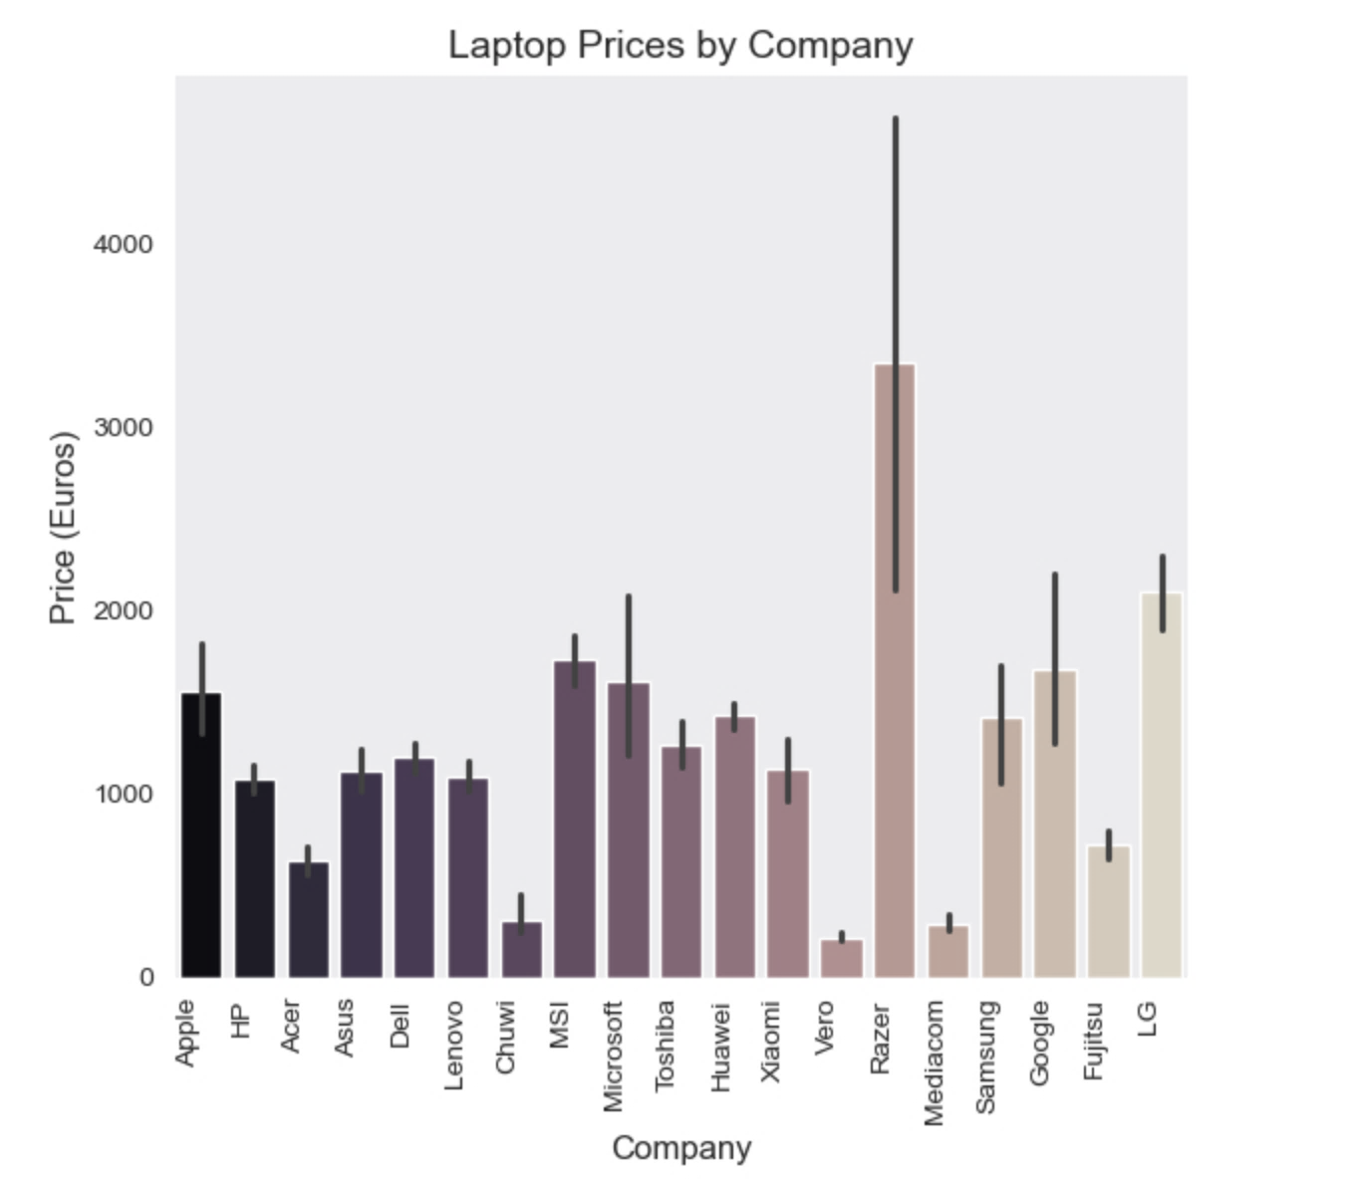
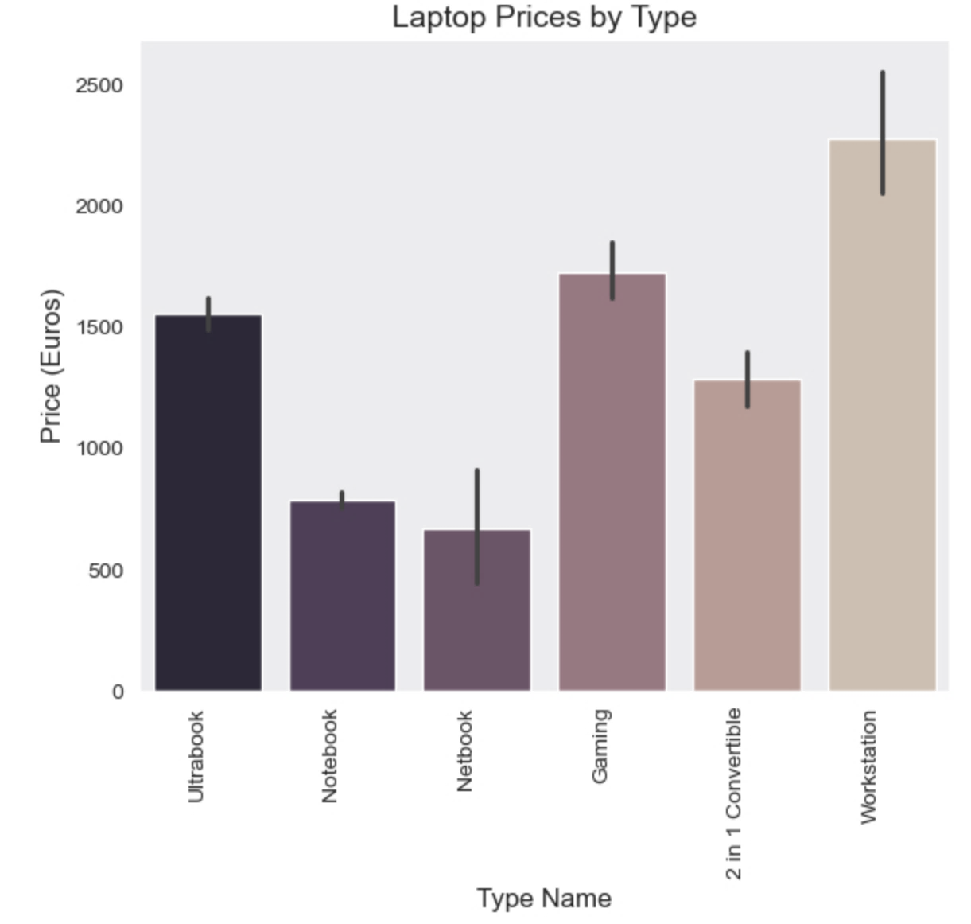
2. By Company and Type
We can observe that most of the companies are budget-friendly while Razer, LG, MSI, Apple, Microsoft and Google are expensive.
From our data, we can conclude that many people prefer notebook and netbook as they are under budget range.

Slide 10
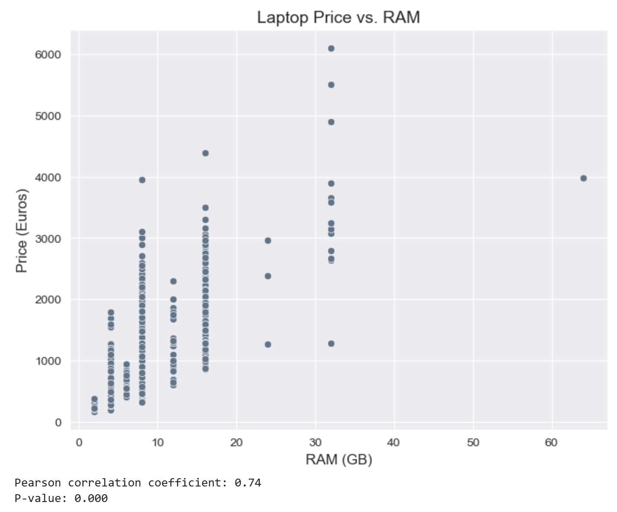
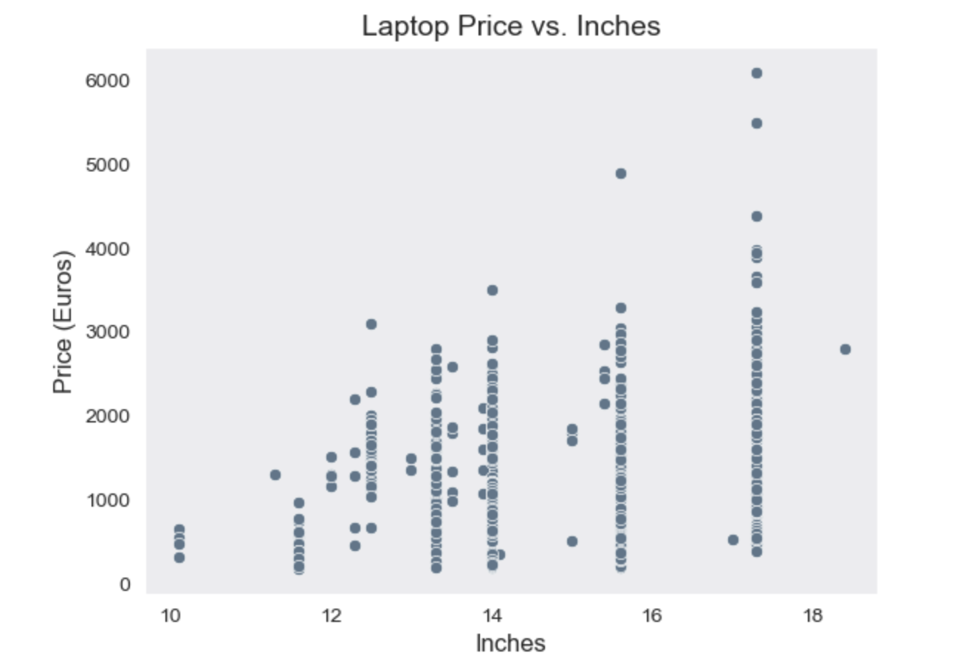
3. Does the price vary with RAM and laptop size?
Since both the columns are numerical, it’s better to use a scatter plot to compare with price column for better understanding.
From the visuals, we can conclude that size column have relationship with price but not a strong relationship between them. On the other hand, RAM is positively correlated with price.

Slide 11
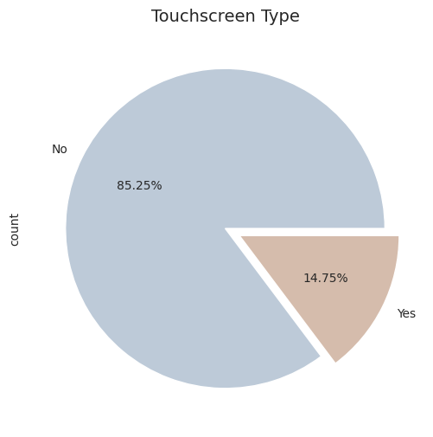
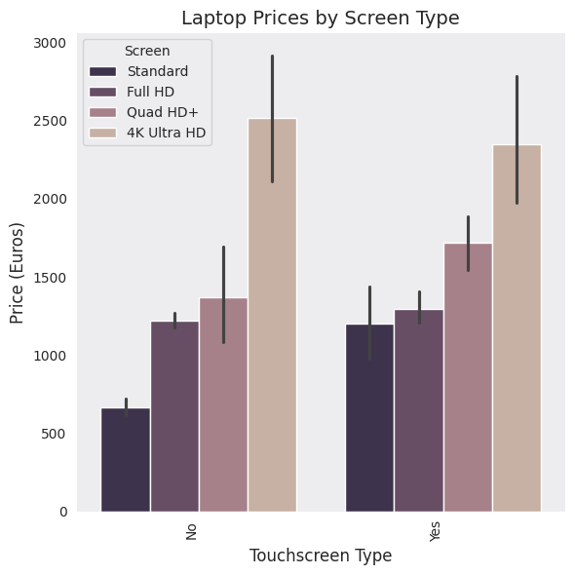
4. By Touchscreen Type
We can see that laptops with touchscreen are very less in number. Also we can conclude that 4K Ultra HD are high priced and it is obvious that high quality screen priced more than the low quality screen.

Slide 12
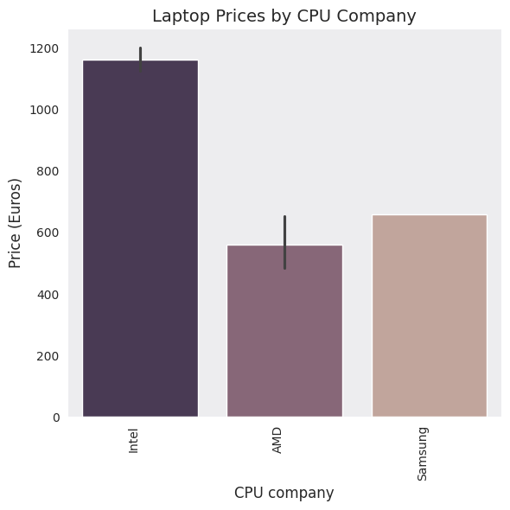
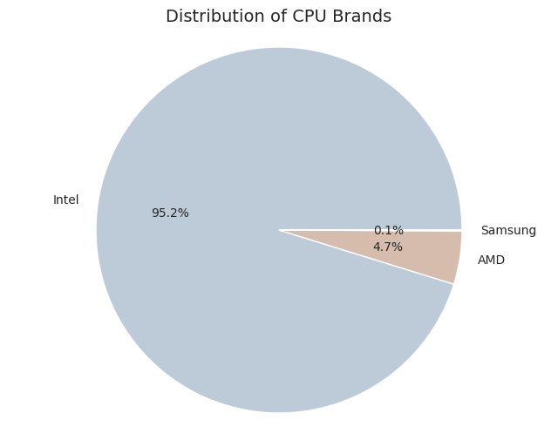
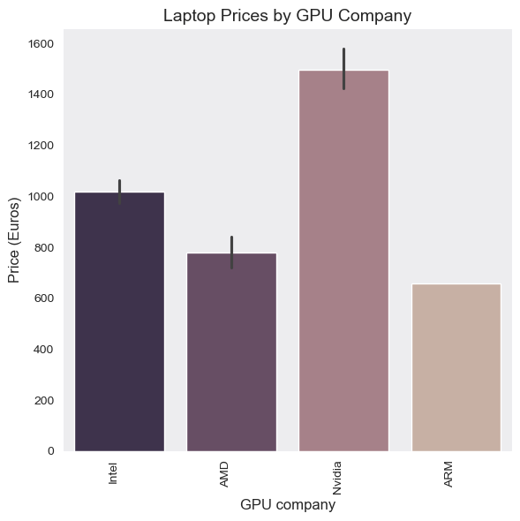
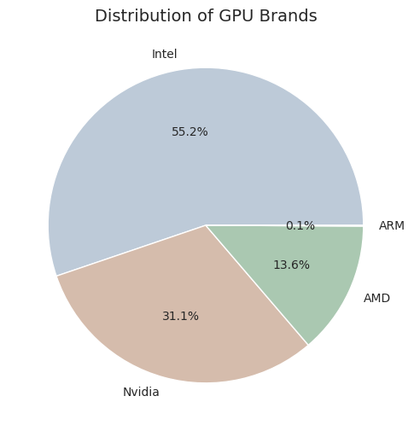
5. Processor and Graphics Processing Unit
We can conclude that most of the laptops use intel processors and they are costly comparing to other brands. When it comes to GPU, Nvidia is costlier than remaining brands.

Slide 13
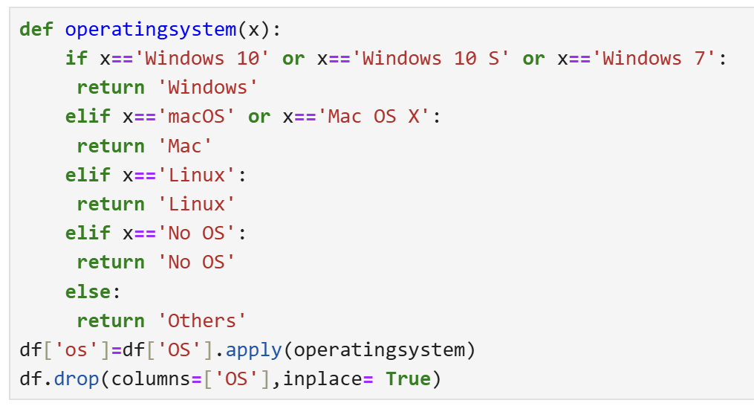
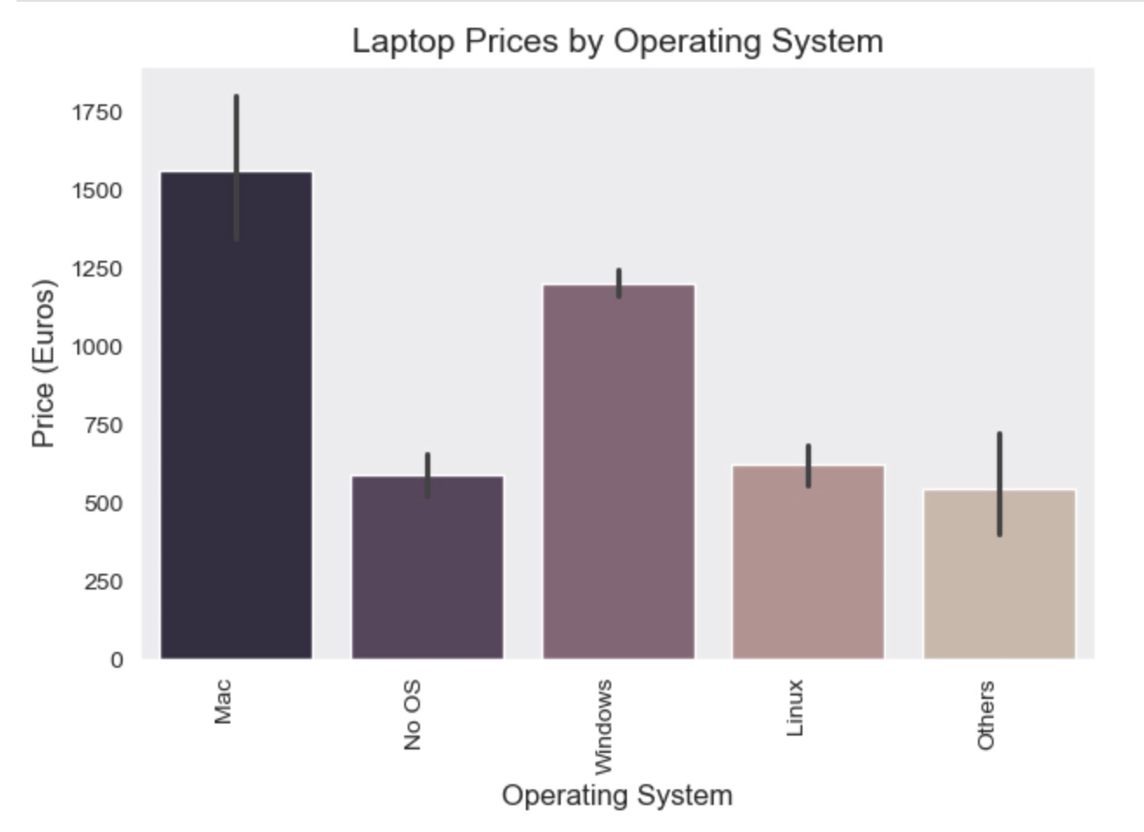
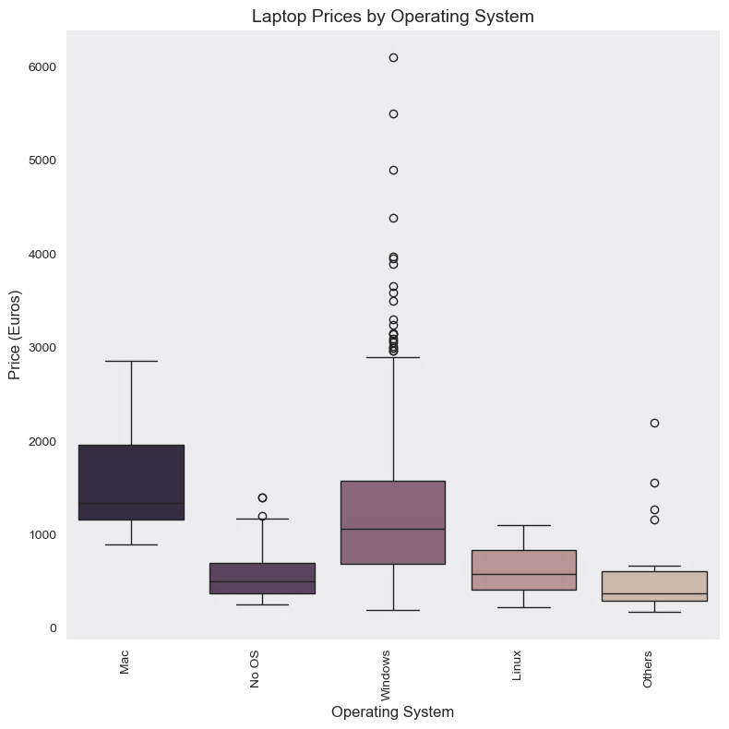
6. Operating System
Here, we have so many categories in operating system. So, first we can check our data and categorise them properly.
We can observe that Windows, Linux starts from low budget where as mac starts from 1000 euros. We can clearly say OS influences price.

Slide 14
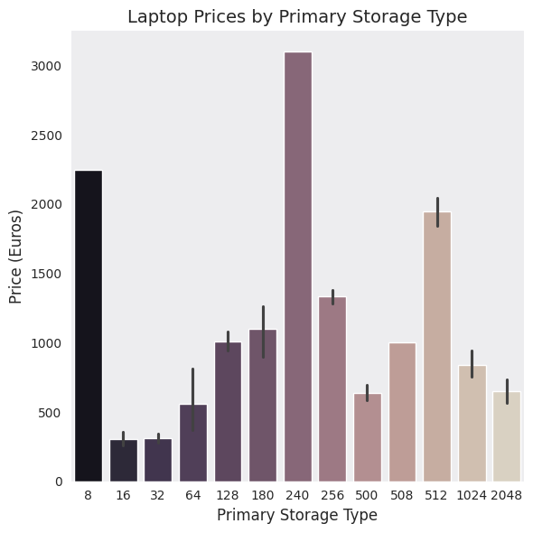
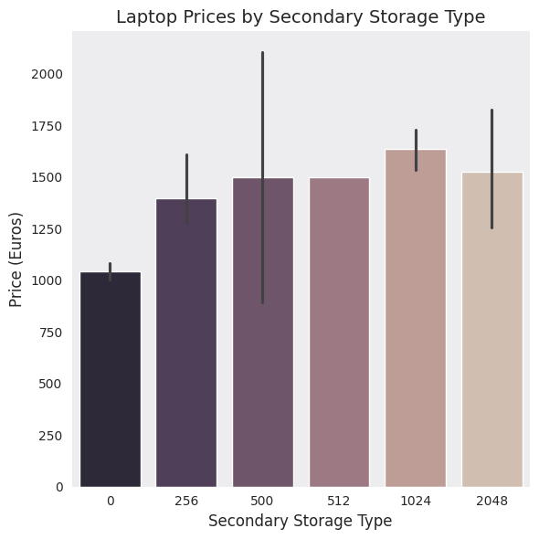
7. Price comparison with Storage Type
We can see that price is almost same for all secondary storage types where as it’s not that much related with primary storage type.

Slide 15
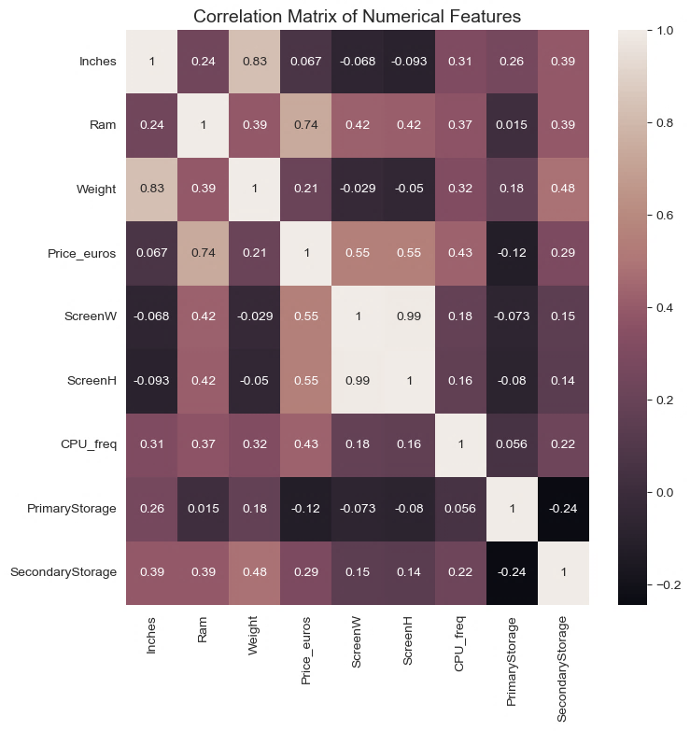
Correlation
Here is our heatmap to check the correlation. It is observed that RAM and screen length are positively correlated with price

Slide 16
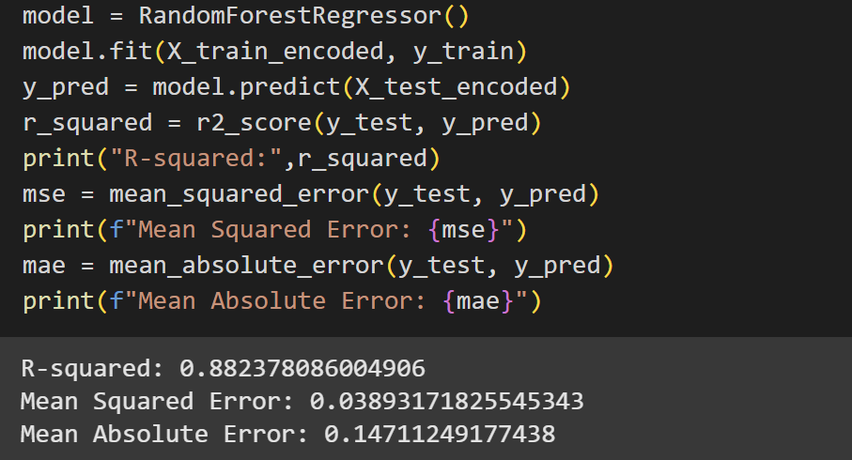
MODEL SELECTION
After performing linear regression and random forest models, our analysis got best accuracy from random forest model.
So, we can evaluate our model through RandomForestRegressor( ).

Slide 17
CONCLUSION
In this project, we analyzed various features affecting laptop prices and built a predictive model using Python.
After data preprocessing, exploratory data analysis (EDA), and feature engineering, we trained multiple machine learning models to predict laptop prices. Among them, the Random Forest Regressor performed the best, achieving an R² score of 0.8823, indicating a strong predictive capability.
This high accuracy suggests that our model effectively captures the relationships between laptop specifications and their market prices.
The insights derived from this analysis can help businesses optimize pricing strategies and assist customers in making informed purchase decisions. Further improvements, such as hyperparameter tuning and incorporating additional features, could enhance model performance even further.

Slide 18


